Slide 1
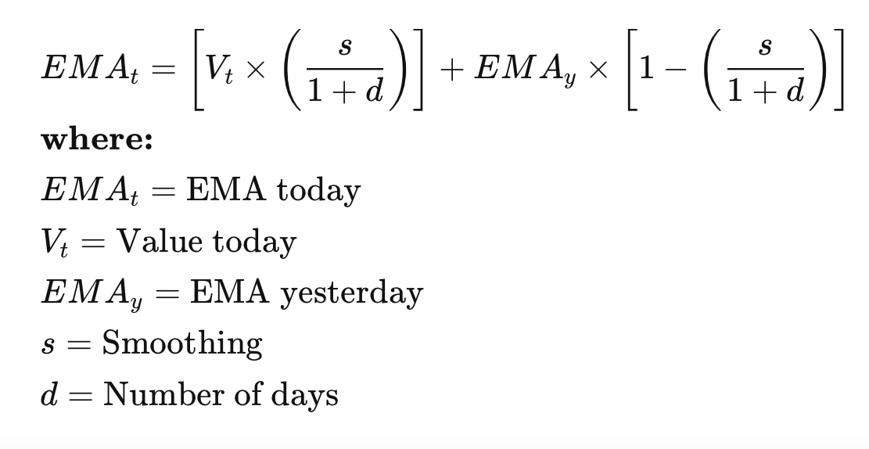
What is HES and how does it work ?
HES is built upon Exponential Smoothing (ES)
ES: forecasts the next value using a weighted average of all previous values where the weights decay exponentially from the most recent to the oldest historical value.

Slide 2
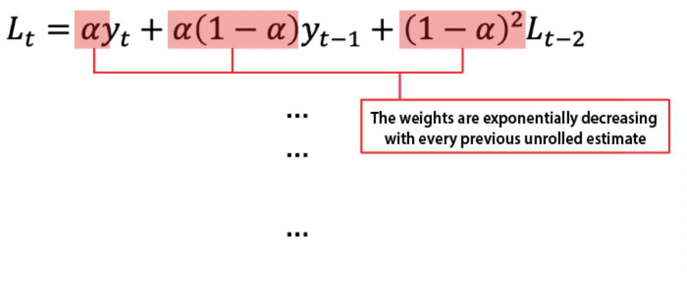
What is HES and how does it work ?
ES: forecasts the next value using a weighted average of all previous values where the weights decay exponentially from the most recent to the oldest historical value.

Slide 3
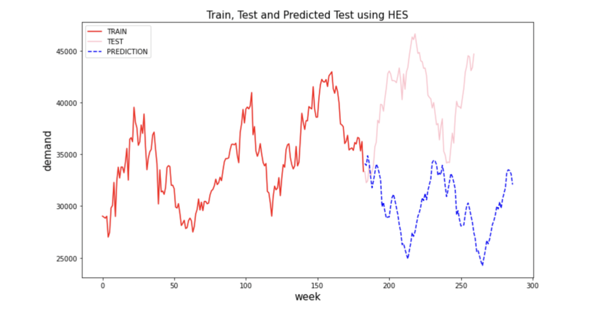
Downwards slope
Nearest data with more weightage
Some peaks with high value but lower weightage

Slide 4
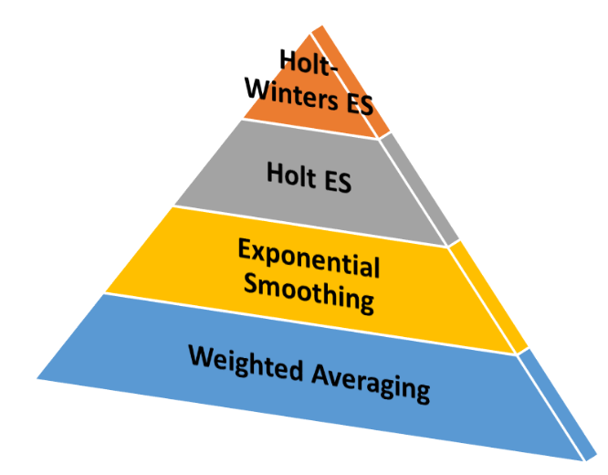
What is HWS and how does it work ?
Based on HES (exponentially decaying weightage average for past data values)
Take into consideration of noise
HWS
 | HES | HWS
Trend | Yes | Yes
Seasonality | Yes | Yes
Damp (Noise) | No | Yes
HES

Slide 5
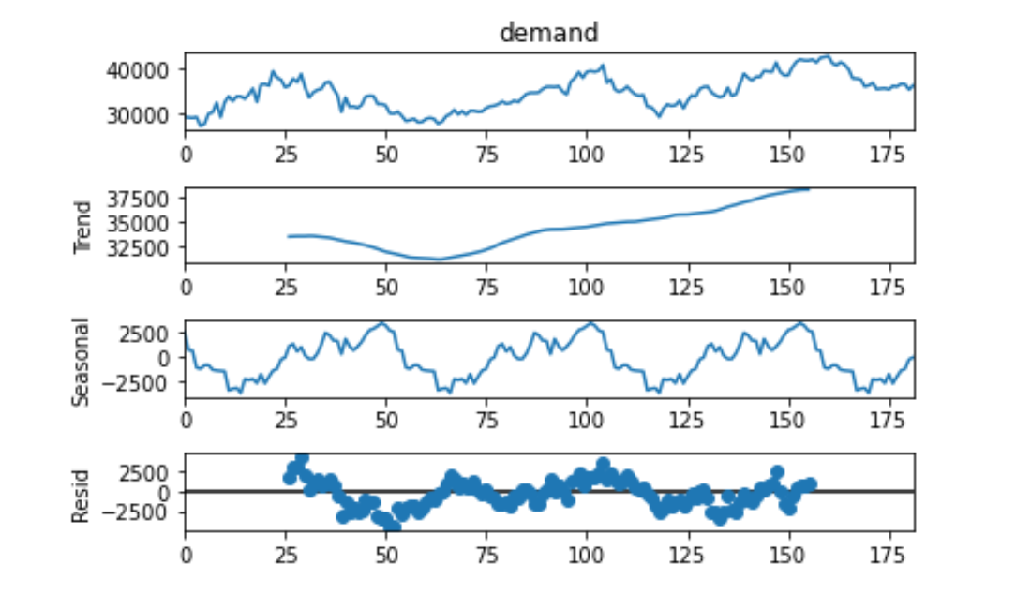
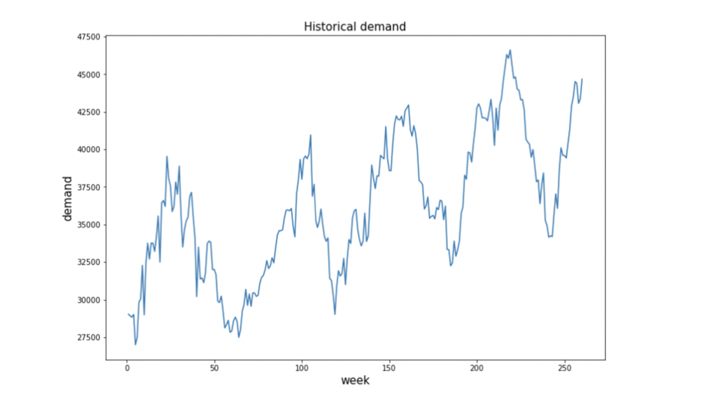
DECOMPOSITION OF DATA

Slide 6
Analysis of Residuals
HWS considers Residuals, which mainly differs it from HES
From the observed trend of residuals, the residuals is going to be increasing, peak and decreasing

Slide 7
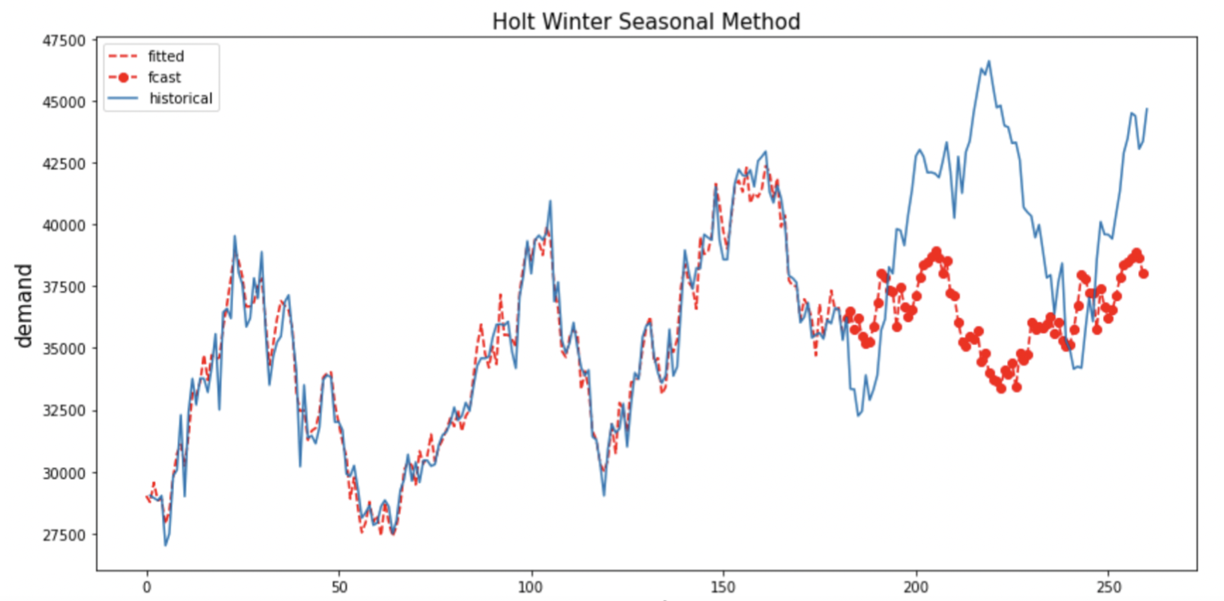
Peak
Residual
Residual
Zero

Slide 8
What is Seasonal Autoregressive Integrated Moving Average ?
ARIMA model predicts a given time series based on its own past values. It can be used for any nonseasonal series of numbers that exhibits patterns and is not a series of random events
Extension of Autoregressive Integrated Moving Average
predicts future values based on past values
(regression)
difference between static data values (stationary statistical means) and previous values
dependency between an observed value and an error in previous data
Component functions
Number of autoregressive terms (variables)
difference in the nonseasonal observations
size of the moving average window
p
d
q

Slide 9
What is Seasonal Autoregressive Integrated Moving Average ?
Extension of ARIMA
Explicitly supports time series data that has a seasonal component
Add new hyperparameters to specify the autoregression (AR), differencing (I) and moving average (MA) for the seasonal component of the series, as well as an additional parameter for the period of the seasonality.
 | ARIMA | SARIMA
Non-seasonal components | p: the number of lag observations in the model -> lag order d: the number of times that the raw observations are differenced -> degree of differencing q: the size of the moving average window -> order of the moving average
Seasonal Components | No | P: Seasonal autoregressive order. D: Seasonal difference order. Q: Seasonal moving average order. m: The number of time steps for a single seasonal period

Slide 10
What is Seasonal Autoregressive Integrated Moving Average ?
Data
Finding hyperparameters (minimise the inaccuracy)
SARIMA Model
Forecast
Different models
Combination
(p,d,q) and (P,Q,D)m

Slide 11
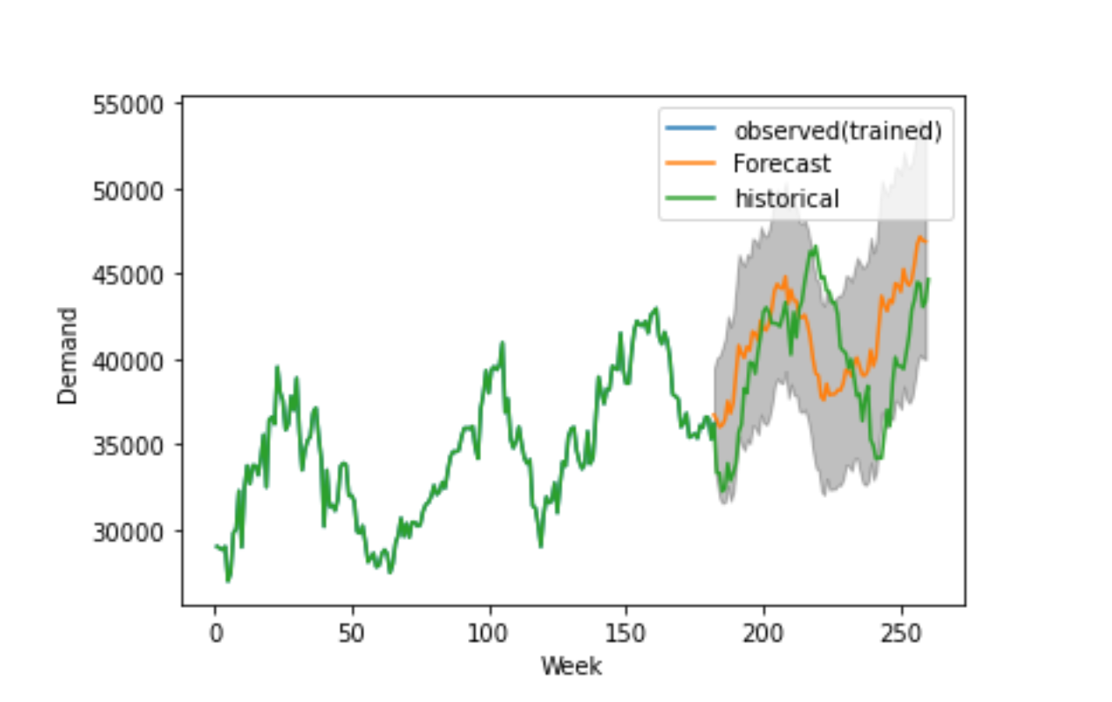
What is Seasonal Autoregressive Integrated Moving Average ?
SARIMA model: SARIMA(p,d,q)(P,D,Q)m
Sets of parameters are integer, but will decide the functioning operation of the forecasting model
SARIMA(3,1,0)(1,1,0)12 # SARIMA(3,1,0)(1,1,0)12
e.g, A P=1 would make use of the first seasonally offset observation in the model, while P=2, would use the last two seasonally offset observations
Full Data Set (100%) | Training Data Set (70%)
SARIMA(1,1,1)(1,1,1)12 | SARIMA(1,1,1)(0,1,1)12

